Slide 1

Starting Out with C++ Early Objects
Tenth Edition
Chapter 18
Linked Lists

Slide 2
Topics
18.1 Introduction to Linked Lists
18.2 Linked List Operations
18.3 A Linked List Template
18.4 Recursive Linked List Operations
18.5 Variations of the Linked List
18.6 The STL list and forward_list Containers

Slide 3
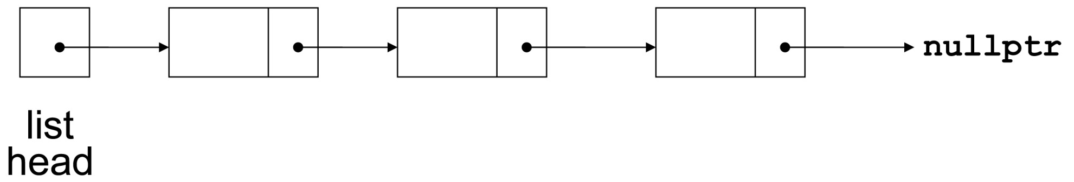
18.1 Introduction to Linked Lists
Linked list: series of dynamically allocated data structures (nodes) with each node containing a pointer to its successor
The last node in the list has its successor pointer set to nullptr

Slide 4
Linked List Terminology
The node at the beginning is called the head of the list
The entire list is identified by the pointer to the head node. This pointer is called the list head.

Slide 5
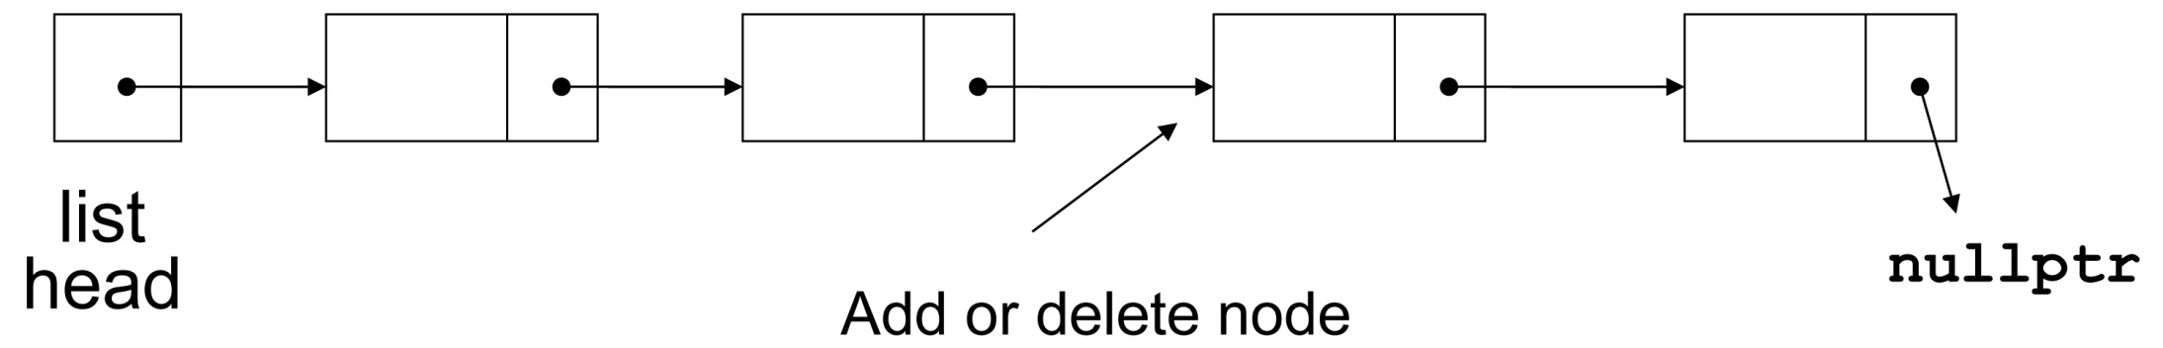
Linked Lists
Nodes can be added to or removed from the linked list during execution
Addition or removal of nodes can take place at beginning, end, or middle of the list

Slide 6
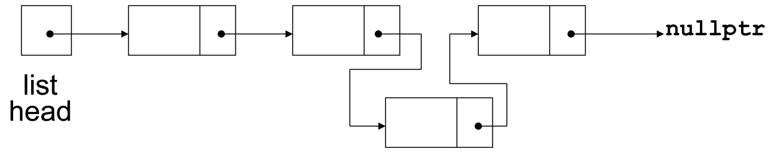
Linked Lists vs. Arrays and Vectors
Linked lists can grow and shrink as needed, unlike arrays, which have a fixed size
Unlike vectors, insertion or removal of a node in the middle of the list is very efficient

Slide 7
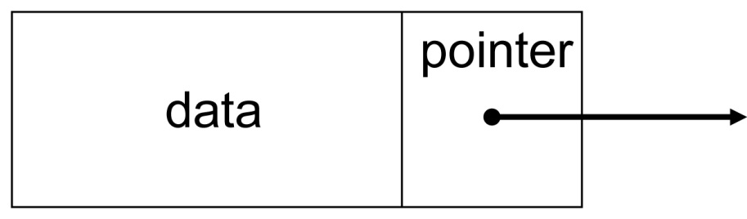
Node Organization
A node contains:
data: one or more data fields – may be organized as structure, object, etc.
a pointer that can point to another node

Slide 8
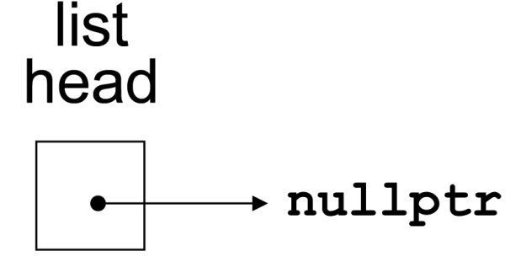
Empty List
A list with no nodes is called the empty list
In this case the list head is set to nullptr

Slide 9
C++ Implementation
Implementation of a node requires a structure containing a pointer to a structure of the same type. This creates a self-referential data structure:
struct ListNode
{
int data;
ListNode *next;
};

Slide 10

Creating an Empty List
Define a pointer for the head of the list:
ListNode *head = nullptr;
Head pointer is initialized to nullptr to indicate that this is an empty list
Notes:
See pr18-01.cpp

Slide 11
C++ Implementation of a Node
Nodes can be equipped with constructors:
struct ListNode
{
int data;
ListNode *next;
ListNode(int d, ListNode* p=nullptr)
{data = d; next = p;}
};

Slide 12
Building a List from a File of Numbers
ListNode *head = NULL;
int val;
while (inFile >> val)
{
// add new nodes at the head
head = new ListNode(val, head);
// Note that assignment is right-to-
// left. The present value of head
// is used when the node is created,
// then the address of the new node
// is assigned to head.
};

Slide 13
Traversing a Linked List 1 of 2
List traversal visits each node in a linked list to display contents, validate data, etc.
Basic process of traversal:
set a pointer to the head pointer
while pointer is not nullptr
process data
set pointer to the successor of the current node
end while
Notes:
See pr18-02.cpp

Slide 14
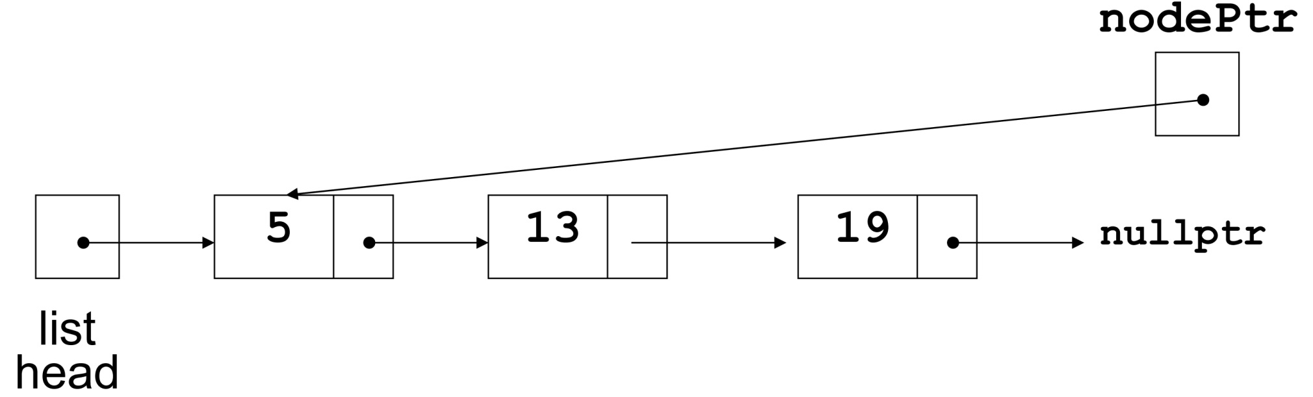
Traversing a Linked List 2 of 2
nodePtr points to the node containing 5, then the
node containing 13, then the node containing 19,
then points to nullptr, and the list traversal stops

Slide 15
17.8 Linked List Operations
Basic operations:
add a node to the list
Delete/remove a node from the list
traverse the linked list
delete/destroy the linked list

Slide 16
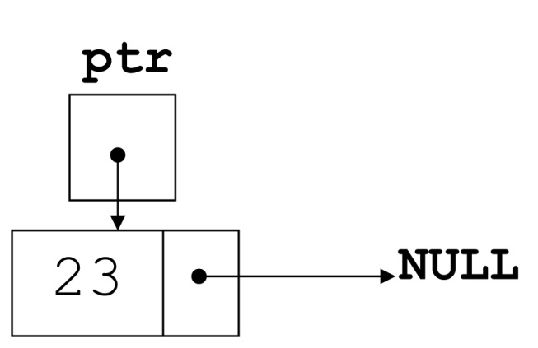
Creating a Node
ListNode *ptr;
int num = 23;
ptr = new ListNode(num);

Slide 17
Adding an Item 1 of 2
To add an item to the end of the list:
If the list is empty, set head to a new node containing the item
head = new ListNode(num);
If the list is not empty,
move a pointer p from head to the last node using
while(p->next != NULL)
p = p->next;
then add a new node containing the item
p->next = new ListNode(num);

Slide 18
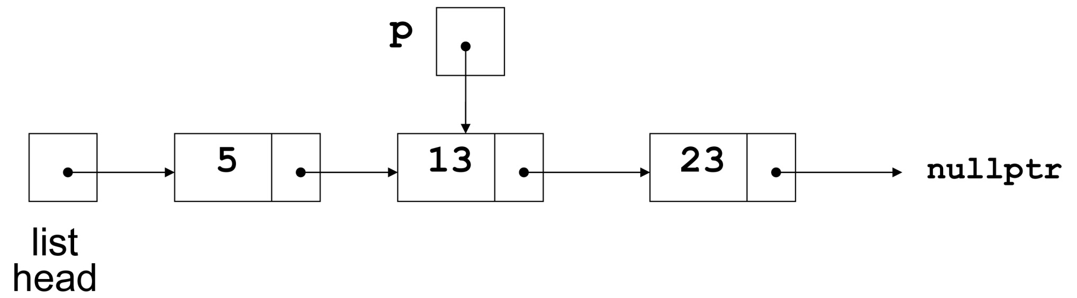
Adding an Item 2 of 2
List originally has nodes with 5 and 13.
p locates the last node, then a node with a new item, 23, is added
Notes:
See NumberList.h, NumberList.cpp, and pr18-03.cpp

Slide 19
Maintaining a Sorted List
You may want to keep the nodes in a linked list in order according to their data fields.
In this case, adding new nodes to the beginning or the end will not work.
Here are two possibilities (ascending order):
The add point is at the head of the list (because the item at the head is already greater than the item being added, or because the list is empty
The add point is after an existing node in a non-empty list

Slide 20
Adding a Node at the Head of a List
Test to see if
head pointer is nullptr, or
node value pointed at by head is greater than value to be inserted
You must test in this order: the results are unpredictable if the second test is attempted on an empty list
Create new node, set its next pointer to head, then point head to it

Slide 21
Inserting a Node after Head in a List
This requires two pointers to traverse the list:
a pointer to locate the node with data value greater than that of node to be inserted, or to locate the end of the list
a pointer to 'trail behind' one node, to point to node before the point of insertion
The new node is inserted between the nodes pointed at by these pointers

Slide 22
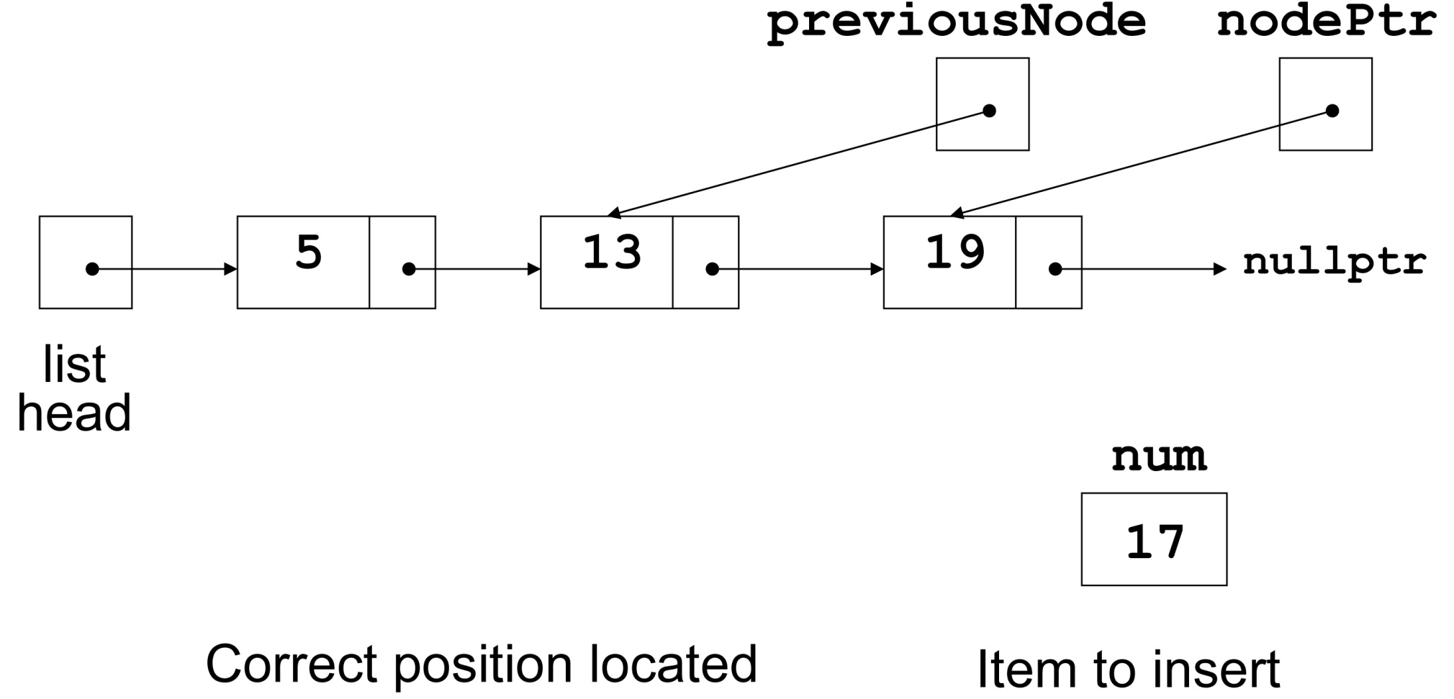
Inserting a Node into a Linked List 1 of 2

Slide 23
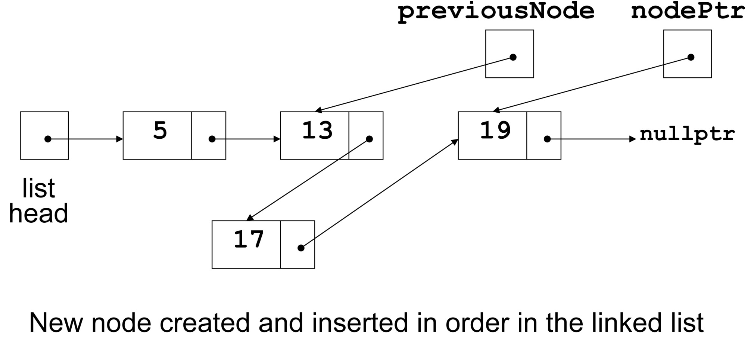
Inserting a Node into a Linked List 2 of 2
Notes:
See SortedNumberList.h, SortedNumberList.cpp, and pr18-04.cpp

Slide 24
Destroying a Linked List
Done using the destructor for the linked list class.
Must remove all nodes used in the list
To do this, use list traversal to visit each node
For each node,
Unlink the node from the list
Free the node’s memory
Finally, set the list head to nullptr

Slide 25
Removing an Element
Find the node to be removed
Remove it from the list
Delete the memory associated with the node
This requires two pointers: one to locate the node to be deleted, one to point to the node before the node to be deleted

Slide 26
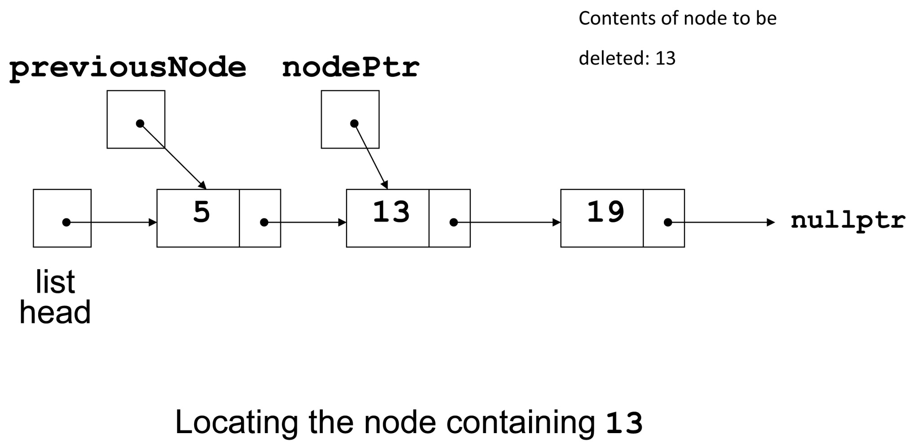
Deleting a Node 1 of 3

Slide 27
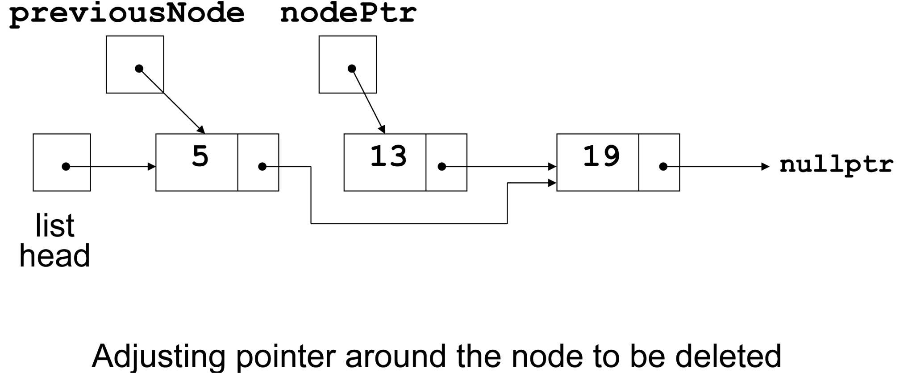
Deleting a Node 2 of 3

Slide 28
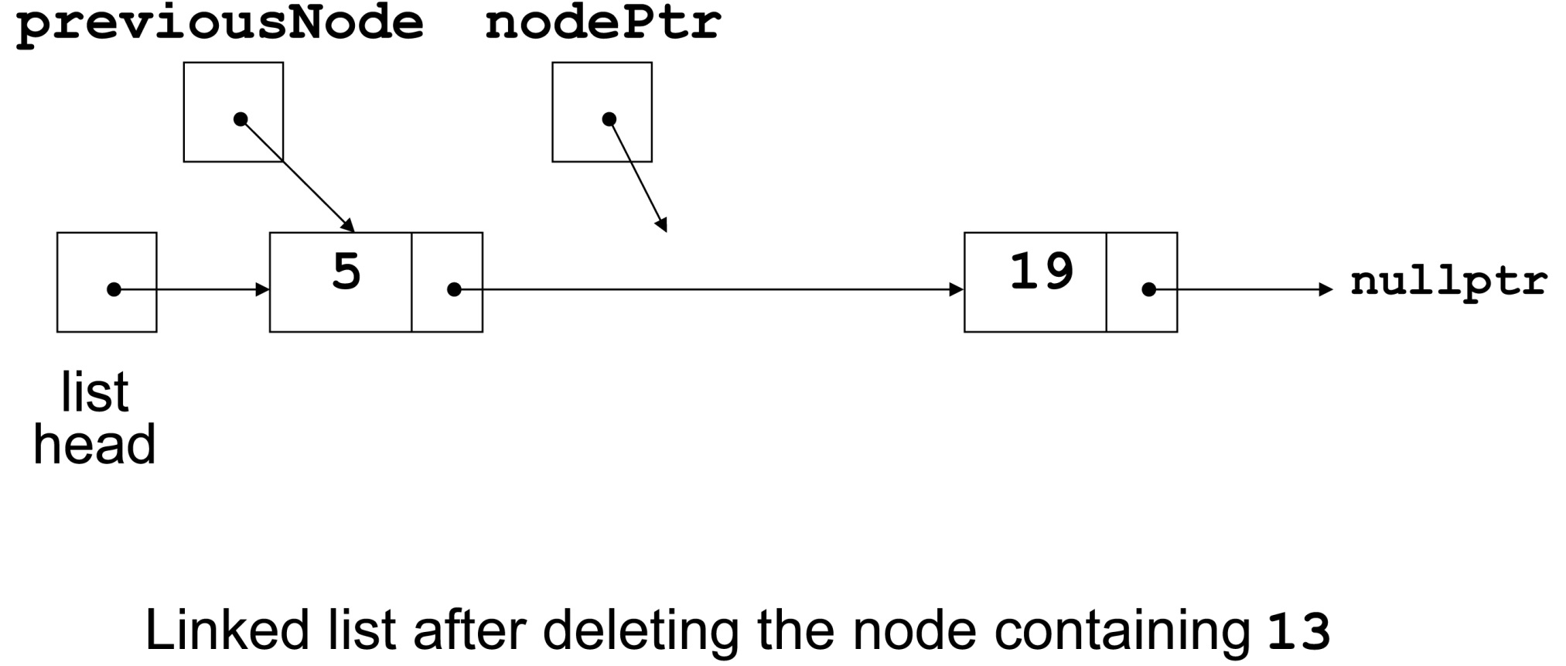
Deleting a Node 3 of 3
Notes:
See NumberList.h, NumberList.cpp, pr18-05.cpp

Slide 29
18.3 A Linked List Template
A linked list template can be written by replacing the type of the data in the node with a type parameter, say T.
If you are defining the linked list as a class template, then all member functions must be function templates
Implementation assumes use with data types that support comparison: == and <=
Notes:
See LinkedList.h and pr18-06.cpp

Slide 30
18.4 Recursive Linked List Operations
A non-empty linked list consists of a head node followed by the rest of the nodes
The rest of the nodes form a linked list that is called the tail of the original list
Many linked list operations can be broken down into the smaller problems by processing the head of the list and then recursively operating on the tail of the list

Slide 31
Find the Size of a Linked List 1 of 2
To find the size (number of elements) of a list
If the list is empty, the length is 0 (base case)
If the list is not empty, find the length of the tail and then add 1 to obtain the length of the original list

Slide 32
Find the Size of a Linked List 2 of 2
To find the size of a list:
int size(ListNode *myList)
{
if (myList == NULL) return 0;
else
return 1 + size(myList->next);
}

Slide 33
Display the Contents of a Linked List
Using recursion to display a list:
void displayList(ListNode *myList)
{
if (myList != NULL)
{
cout << myList->data << " ";
displayList(myList->next);
}
}
Notes:
See pr18-07.cpp

Slide 34
Other Recursive Linked List Operations
Add and remove operations can be written to use recursion
General design considerations:
The base case is often when the list is empty
The recursive case often involves the use of the tail of the list (i.e., the list without the head). Since the tail has one fewer entry than the list that was passed in to this call, the recursion eventually stops.
Notes:
See NumberList2.cpp, NumberList2.h, and pr18-08.cpp

Slide 35
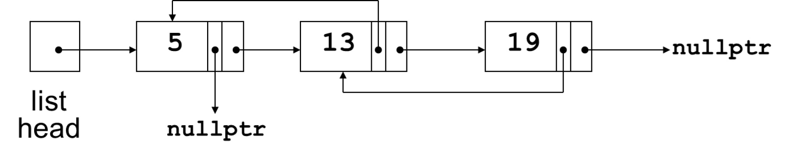
18.5 Variations of the Linked List 1 of 2
Other linked list organizations:
doubly-linked list: each node contains two pointers: one to the next node in the list, one to the previous node in the list

Slide 36
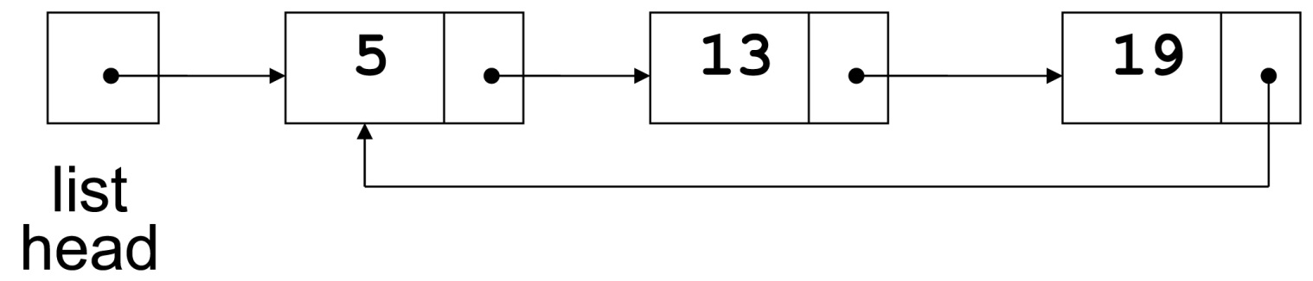
Variations of the Linked List 2 of 2
Other linked list organizations:
circular linked list: This is a singly-linked list in which the last node in the list points back to the first node in the list, not to nullptr

Slide 37
Smart Pointers and Linked Lists
Smart pointers are generally helpful in preventing common problems such as memory leaks, inadvertent deletion, and multiple deletion.
They may not be useful in implementing linked lists:
Unique pointers cannot be used due to ownership
Shared pointers add the overhead of shared groups
Shared pointers in a circularly-linked list may lead to memory leaks when trying to destroy a list

Slide 38
18.6 The STL list and forward_list Containers
Sequence containers in the STL with underlying linked lists in their implementation
list: uses and underlying doubly-linked list
forward_list: uses a singly-linked list
Unlike other sequence containers, cannot go directly to an element via an index. Access is sequential from the first to the last element.

Slide 39
list and forward_list Containers
Constructors: default, 2 fill constructors (fill with zero or with a given value), copy constructor, range constructor.
Lots of member methods, many already seen in Chapter 17.
Use online references to learn about the small differences in member methods between the two containers.
Notes:
See pr18-09.cpp

Slide 40

Copyright

